Slide 1
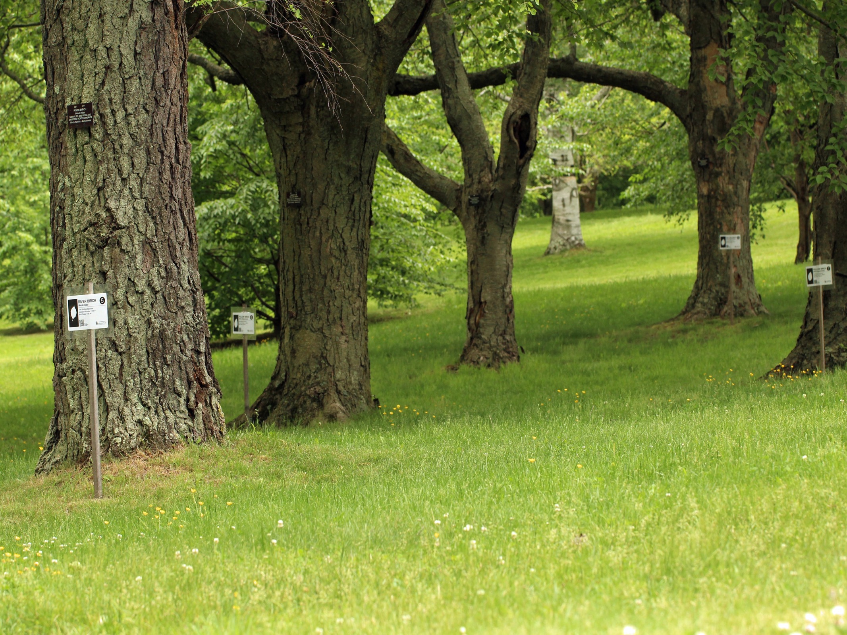





Temporal Ecology Lab, Harvard University
Suzanne Mrozak, Volunteer Coordinator
Danny Schissler, Intern
Cat Chamberlain, Graduate Student

Slide 2
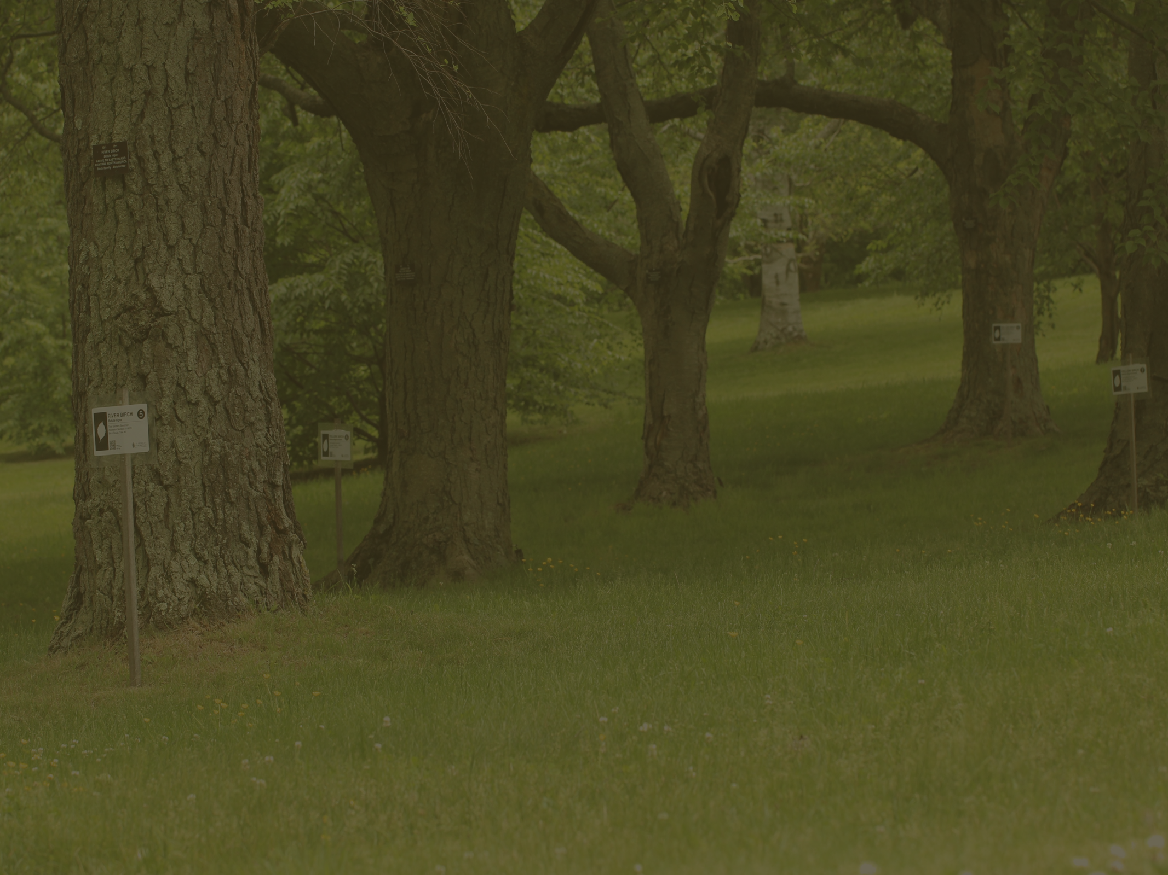
OVERVIEW
The Tree Spotter Story
Our Volunteers
The Numbers
Graphs and Figures
Photos
Tree Spotter Song
THANK YOU!

Slide 3
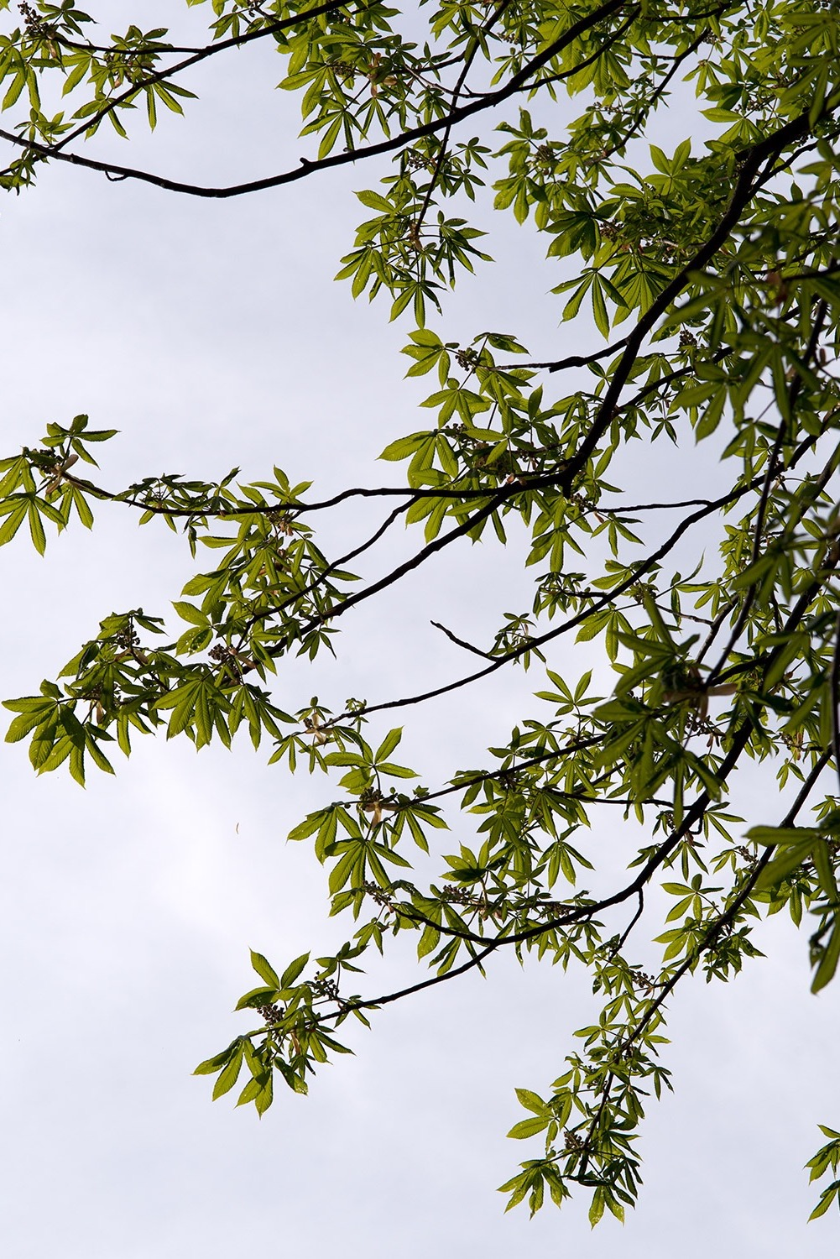
Our Story
The Tree Spotters Citizen Science Program started nearly two years ago through Lizzie Wolkovich’s Temporal Ecology Lab.
The first meeting for the project was held March 25, 2015.
The aim of the project is to work with local citizen scientists and collect phenological observations for 55 individual trees throughout the arboretum.
Volunteers record observations for 11 different phenophases in Nature’s Notebook, an online portal system through the USA National Phenology Network (NPN).

Slide 4
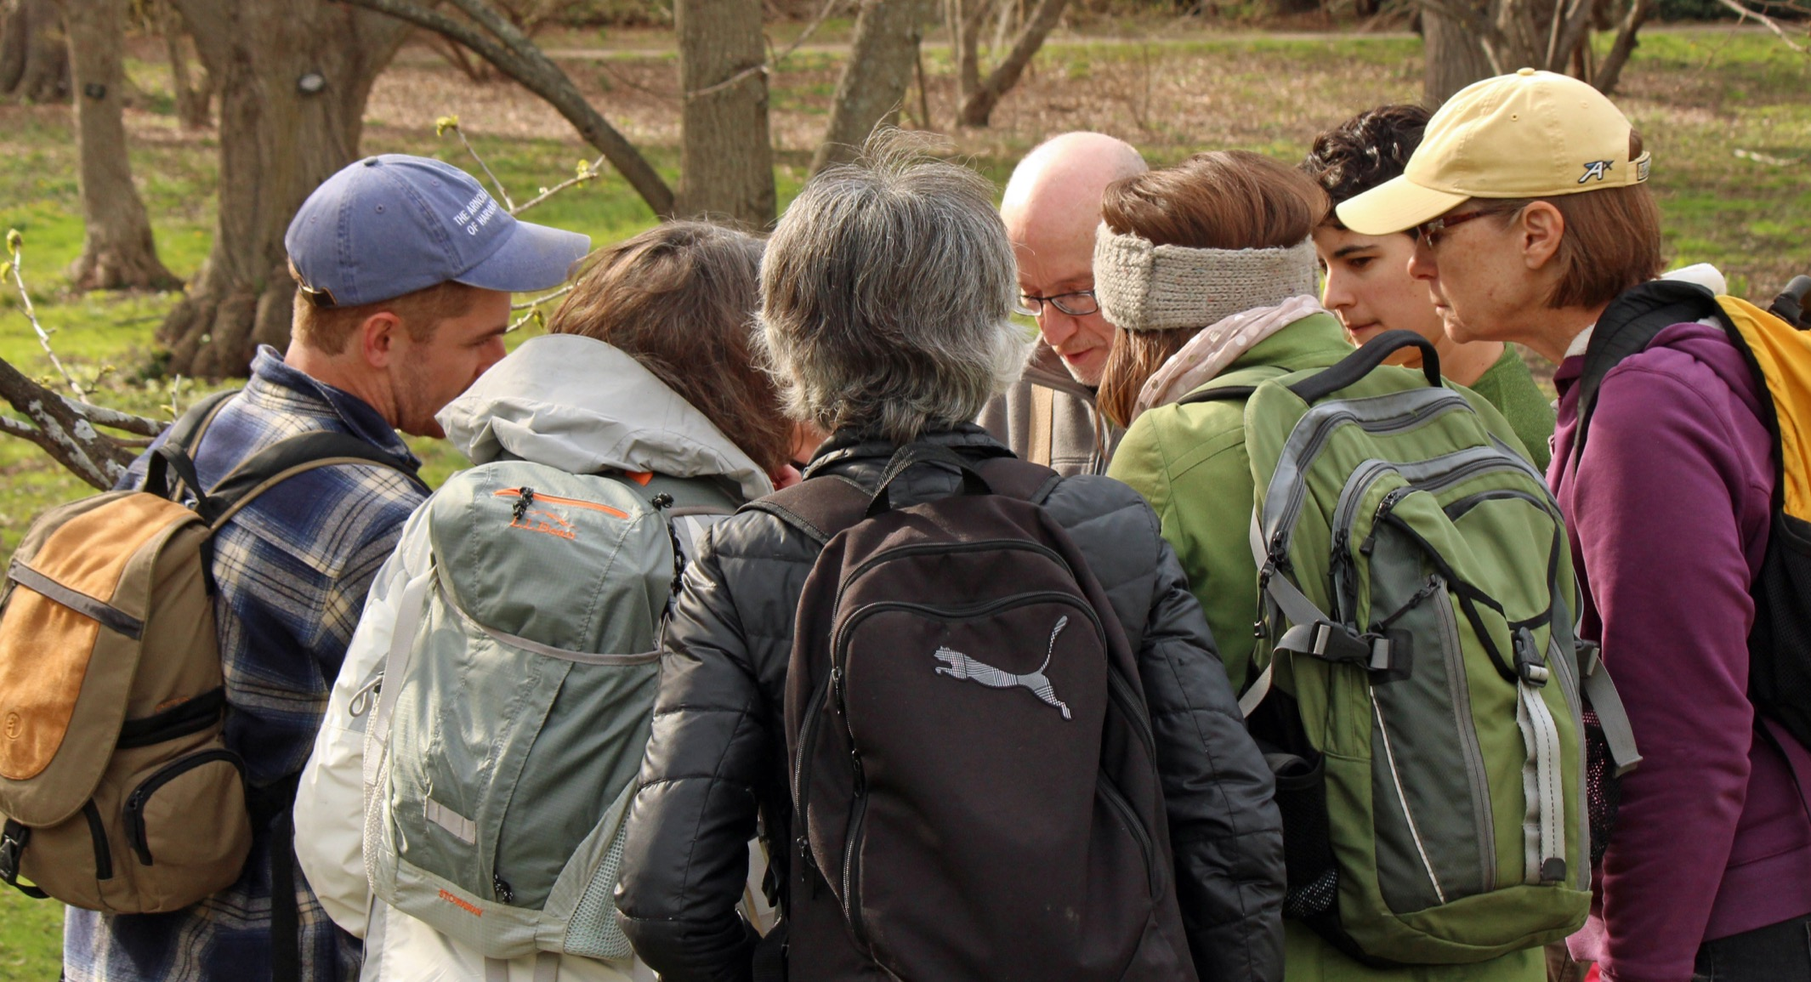
Our Volunteers

Slide 5
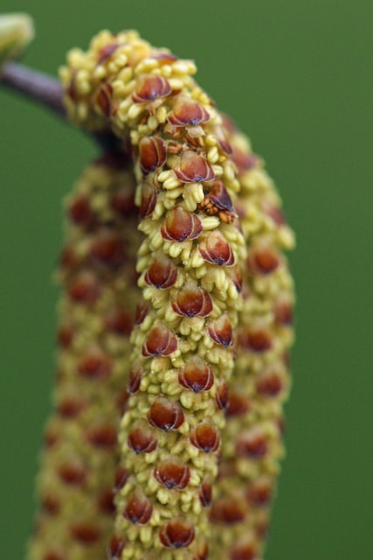
The numbers
The first training session was held May 17, 2015.
So far, there have been 196 individuals in the local community trained to Tree Spot.
Of those 196 trained, 64 observers are still active today, which gives us a retention rate of 32.65%!
The NPN recommends striving for a retention rate of 20%.
169 Tree Spotter volunteers have registered accounts on the Nature’s Notebook website, giving us a success rate of 37.87% of users who have completely signed up and been trained.
We are SO pleased with our volunteers!! Thank you!

Slide 6
Total observations and observers per tree this year
Common Name
The oaks have the fewest number of observations and observers

Slide 7
Total number of observers for each species

Slide 8
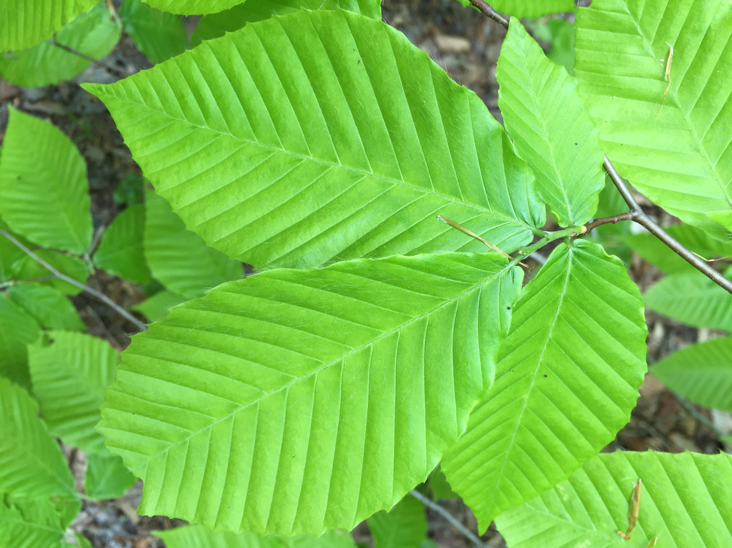
As of Thursday, December 1, 2016
Tree Spotters have recorded…
65,191
observations in Nature’s Notebook!
The Appalachian Trail Conservancy has recorded only 45,329 observations in that same timeframe.

Slide 9
You have all helped me with my work…

Slide 10
Another dataset from USA-NPN I investigated…

Slide 11
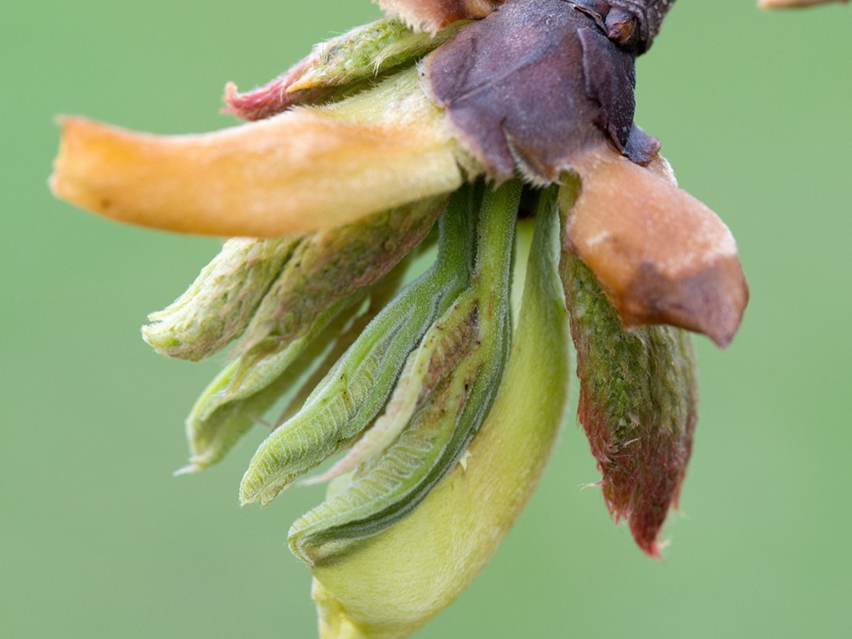
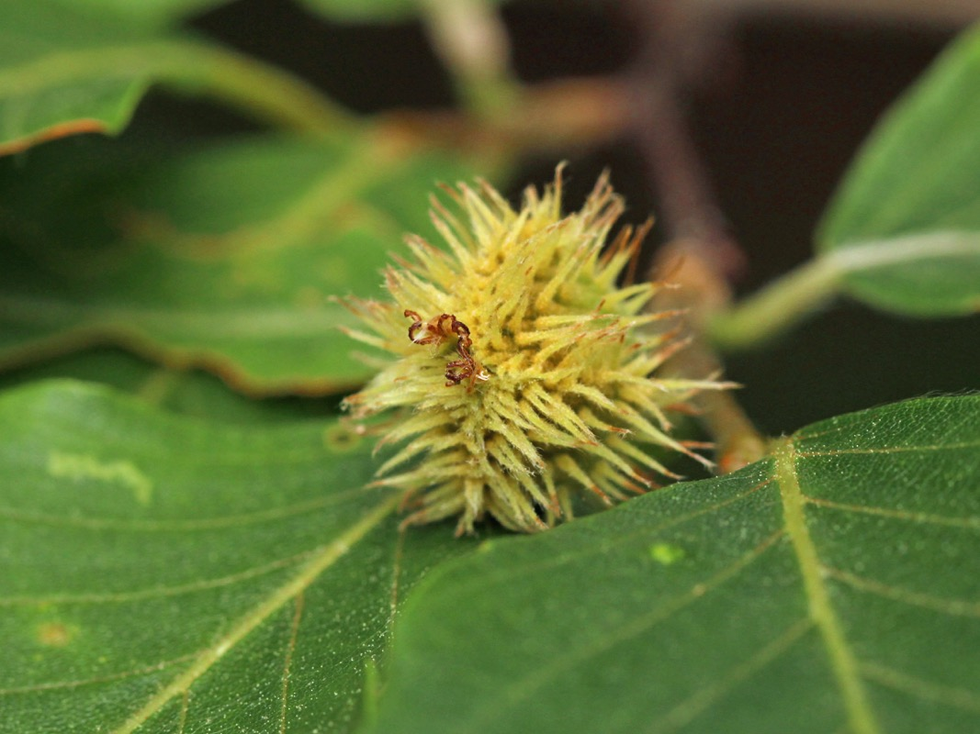
Photographs from our flickr site
Shagbark Hickory
https://www.flickr.com/groups/arnold_arboretum_tree_spotters/
American Beech

Slide 12
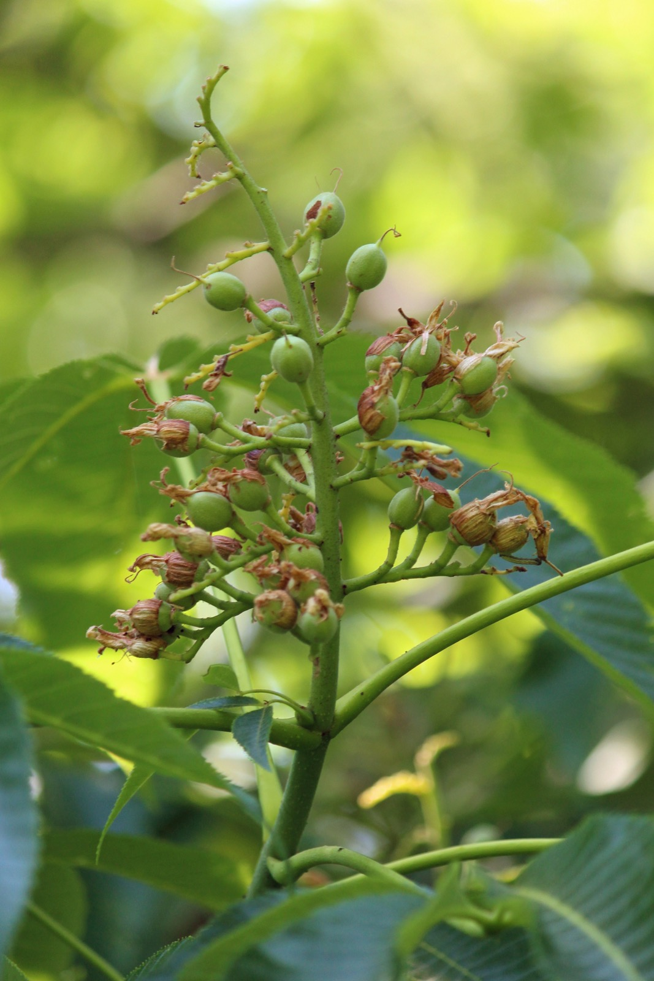
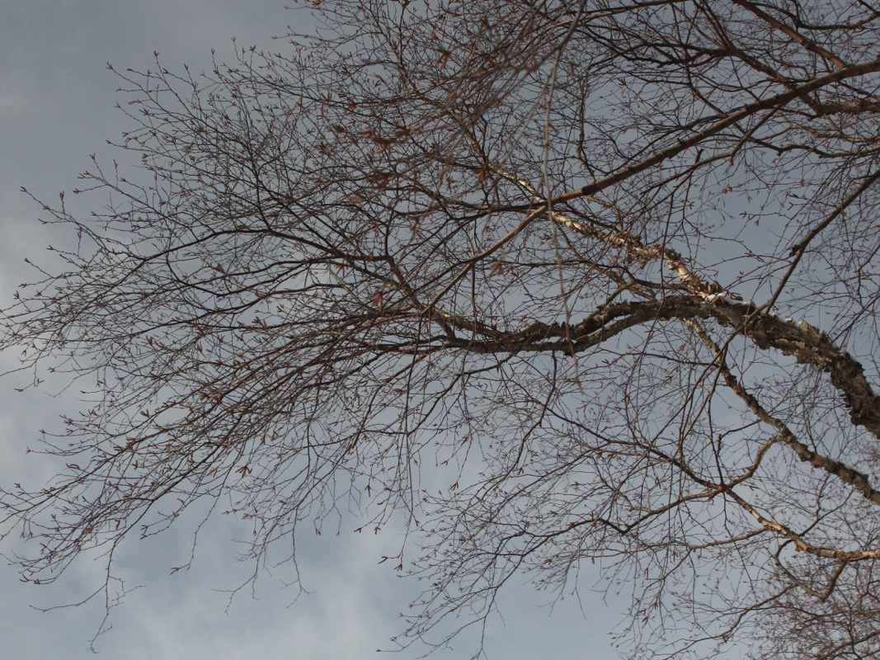
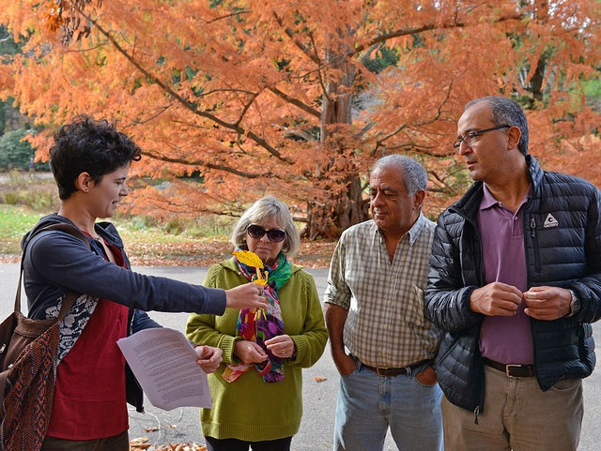
River Birch
Yellow Buckeye

Slide 13
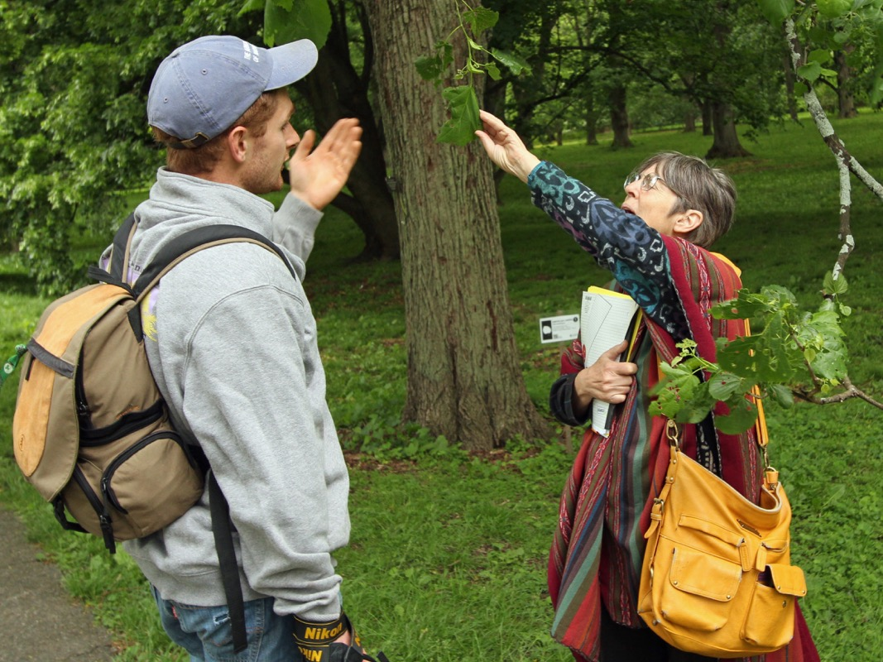
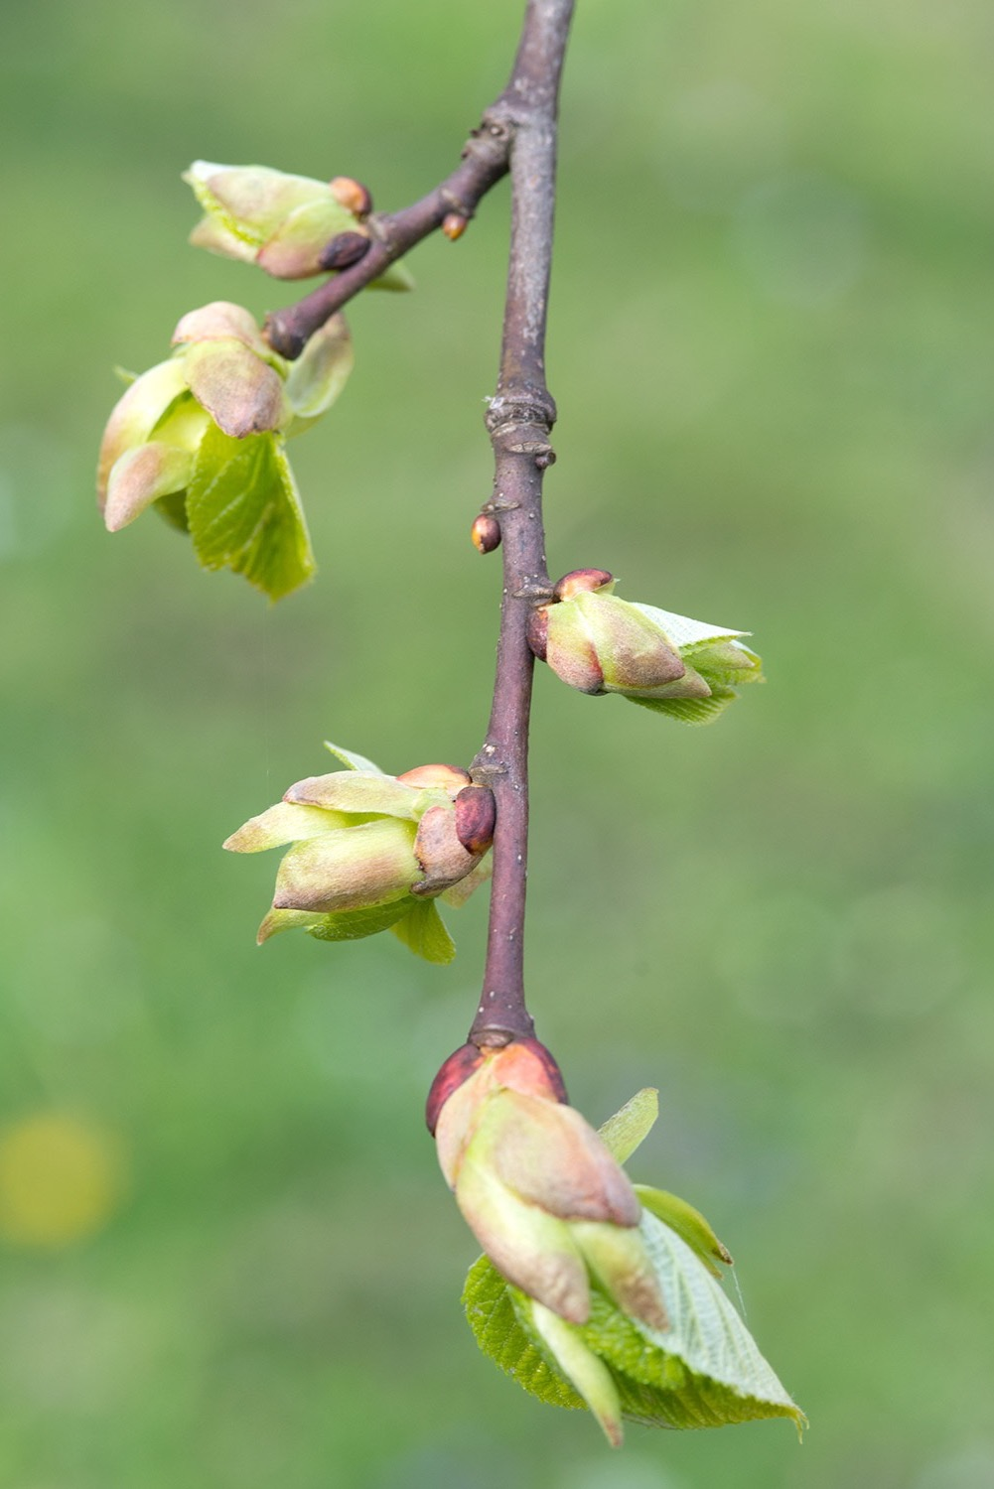
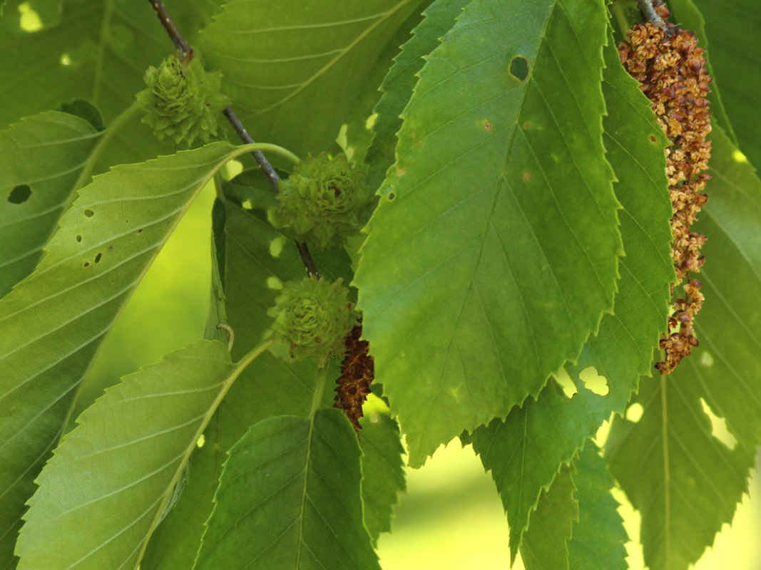
Yellow Birch
American Basswood

Slide 14
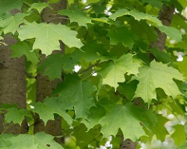
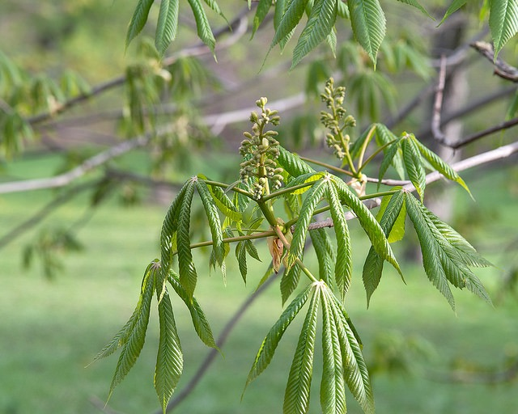

Slide 15
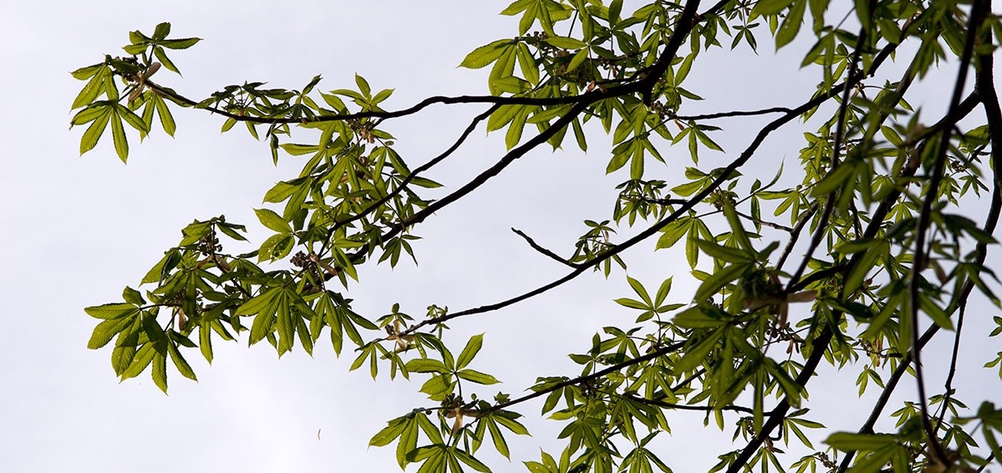
Thank you, Volunteers, for being so dedicated.
There is no way we could do this without you.

